Slide 1
GOVT. COLLEGE ROPAR
DEPARTMENT OF ECONOMICS
TOPIC -: MAIN FEATURE OF
UNDERDEVELOPED ECONOMY
MEAING OF UNDERDEVELOPED ECONOMY.
CHARACTERISTICS OF UNDERDEVELOPED ECONOMY.
DIFFERENCE BETWEEN DEVELOPED & UNDERDEVELOPED.
CONCLUSION.
PROF. RITU CLASS- B.A 3SEM 5

Slide 2
MEANING OF UDERDEVELOPED ECONOMY-:
An underdeveloped economy is that economy which is characterized by the widespread poverty , the low economy performance of the economy as compared to advanced economies and underutilization of production potential.
According to first five year plan, “ an underdeveloped economy is an economy is characterized by the co- existence in greater or less degree of underutilized mam power on the hand and of unexploited natural resources on the other.”

Slide 3
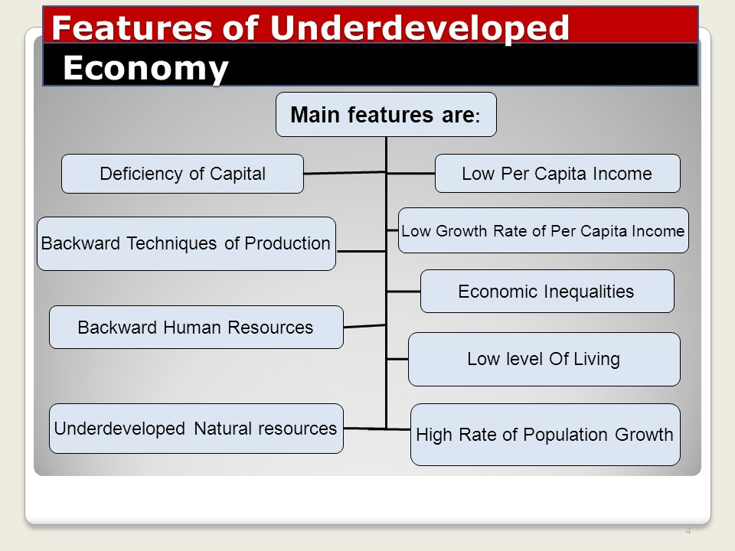
MAIN FEATURES OF UNDERDEVELOPED ECONOMY-:

Slide 4
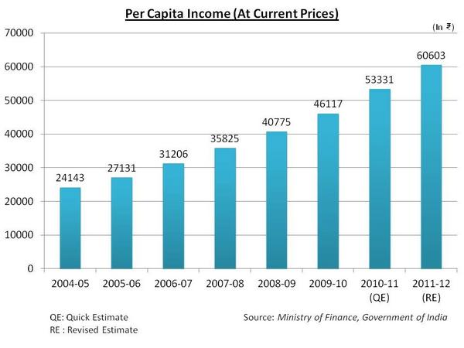
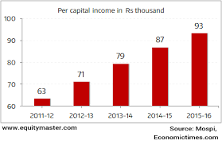
1.LOW PER- CAPITA INCOME-:Almost all underdeveloped countries of the world show low per capita income in comparison to developed countries of the world

Slide 5
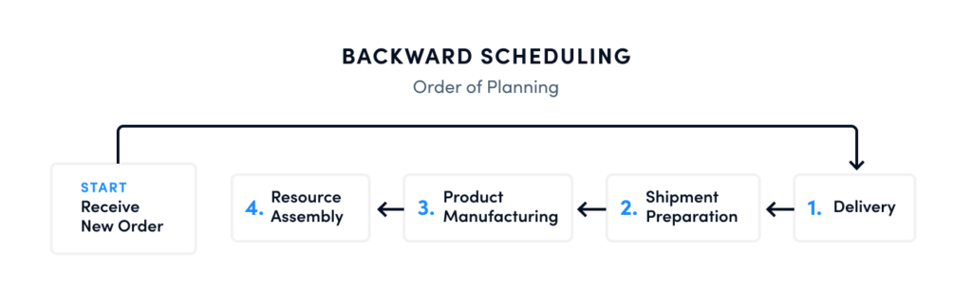
2.DIFICIENCY OF CAPATAL-: When operating under a capital deficit, a company runs the risk of not being able to sustain itselfs should it fail to make expected sales. A capital deficit also puts a company at risk of peril if one of the places in which it has invested its capital should experience difficulties.
3.BACKWARD TECQUINE OF PRODUCTION-: Backward scheduling is when businesses make their items at the last possible available period before the due date. The order starts with a planned receipt date or due date – one which is usually defined upon the customer's order.

Slide 6
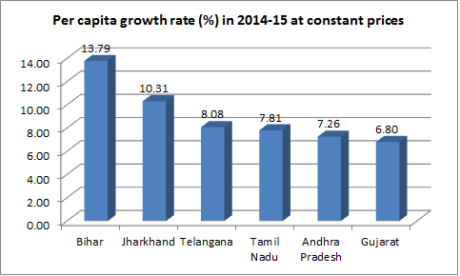
4. LOW GROWTH RATE OF PER CAPITA INCOME-: Annual growth rate of real Gross Domestic Product (GDP) per capita is calculated as the percentage change in the real GDP per capita between two consecutive years. Real GDP per capita is calculated by dividing GDP at constant prices by the population of a country or area.

Slide 7
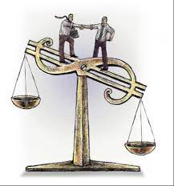
5. LOW PRODUCTIVITY OF LABOUR-: Labour productivity is a measure of economic performance that compares the amount of goods and services produced (output) with the number of hours worked to produce those goods and services. The BLS also publishes measures of multifactor productivity.
6. ECONOMIC INEQUALITIES-: Economic inequality is the unequal distribution of income and opportunity between different groups in society. It is a concern in almost all countries around the world and often people are trapped in poverty with little chance to climb up the social ladder

Slide 8
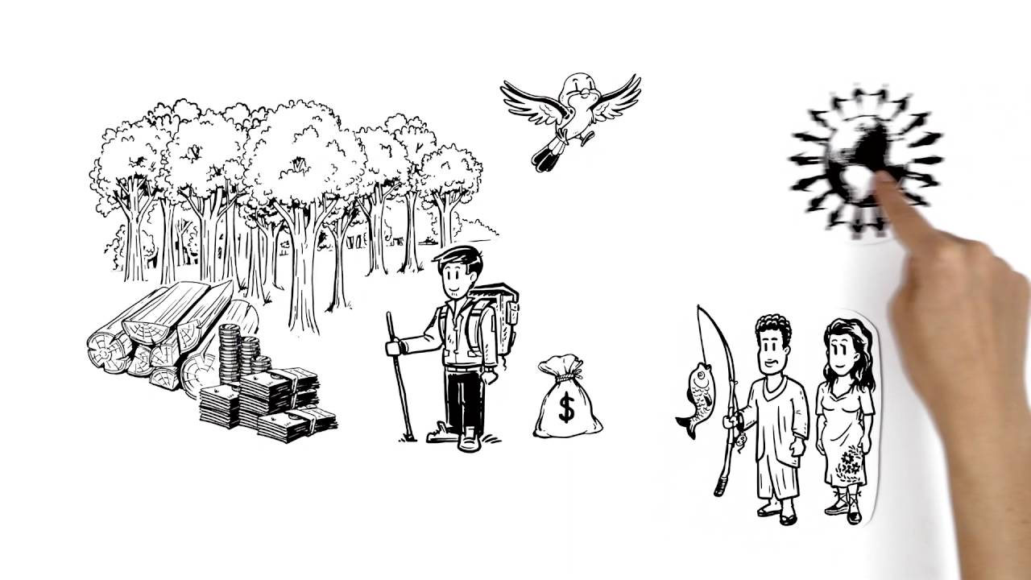
7. LOW LEVEL OF LIVING-: An example of a low standard of living is a poor person who does not have enough food or water. A measurement of how well off a group of people or an individual perceive themselves to be.
8. MISUSE OF NATURAL RESOURCES-: Misuse of natural resources; refers to excessive use, destructive use or achieving imbalance between resources either individually or in combination. Use of natural resource; appropriate apply of natural resource. Ethiopia use water and soil for much activity.

Slide 9
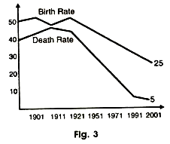
9.HIGH RATE OF POPULATION GROWTH-: These countries than deathrate due to there conservative atitude and illetracy and the people involve in production working pepole. Tgats why their national income is also low under developed country had these feature.

Slide 10
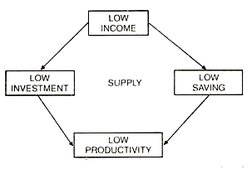
10. VICIOUS CIRCLE OF POVERTY-: Vicious circle of poverty implies a circular constellation of forces tending to act and react upon one another in such a way as to keep a poor country in a state of poverty. This situation can be summed up in the proposition A COUNTRY IS POOR BECAUSE IT IS POOR.

Slide 11
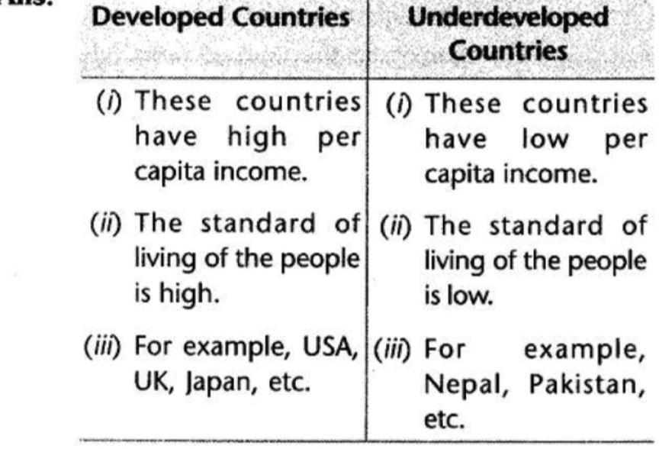
DIFFERENCE BETWEEN DEVELOPED & UNDERDEVELOPED-:

Slide 12
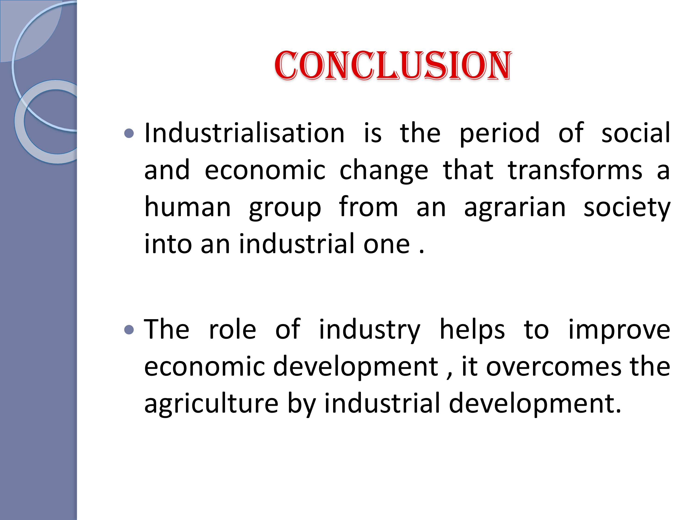
A

Slide 13
THANK YOU
A

